Slide 1
DSC 640 – Week 3 & 4 Michael Ersevim

Slide 2
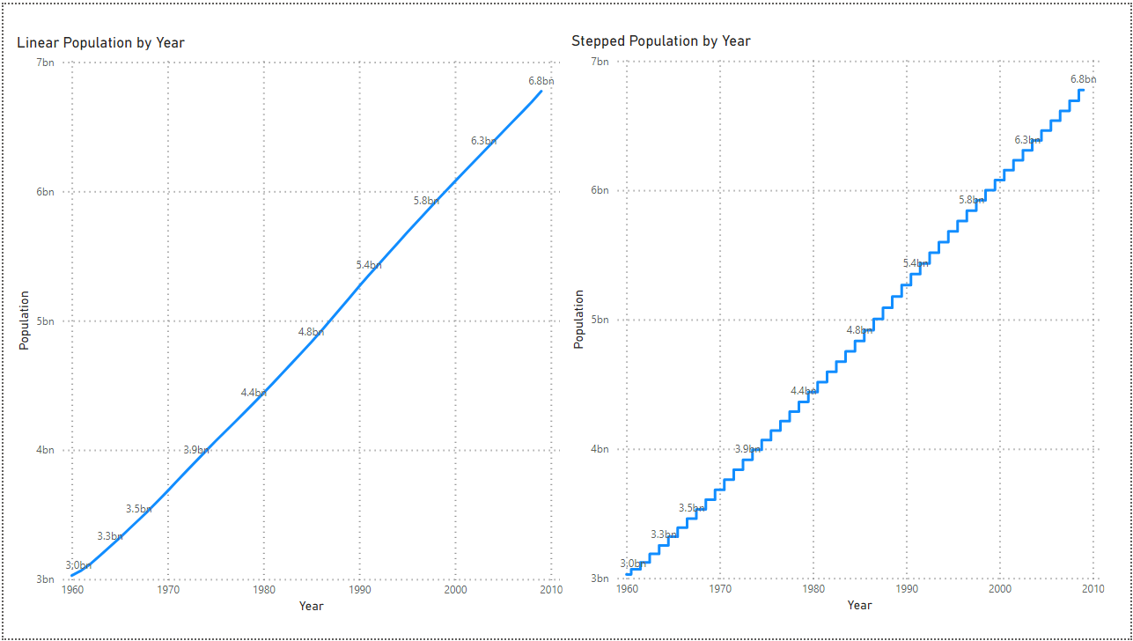
Power BI: Line and Stepped graphs of world population

Slide 3
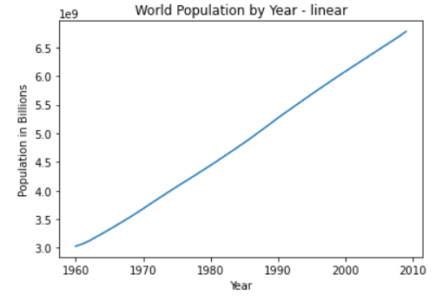
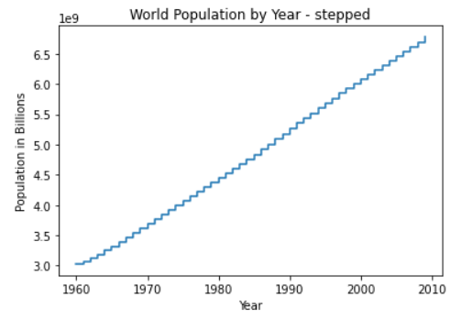
Python: Line and Stepped graphs of world population

Slide 4
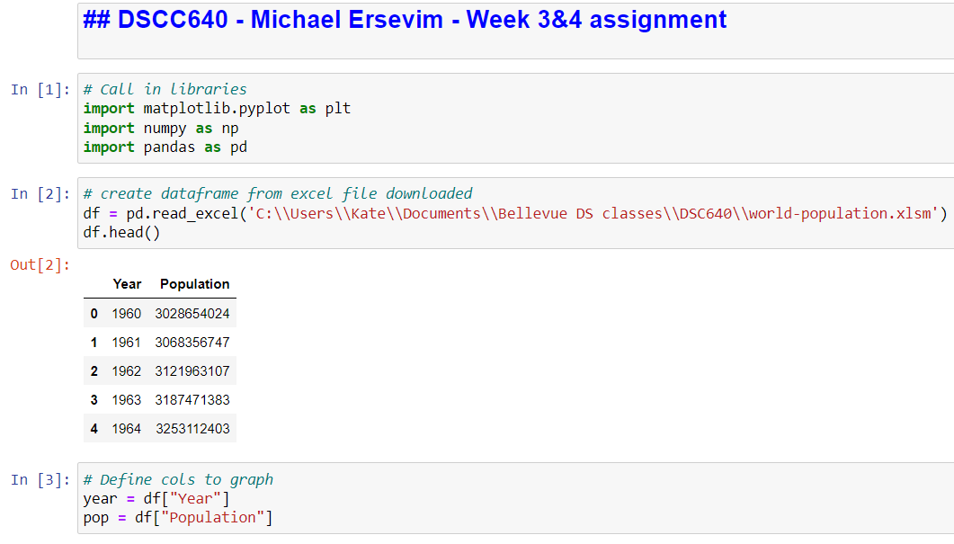
Python: Line and Stepped graphs of world population - CODE

Slide 5
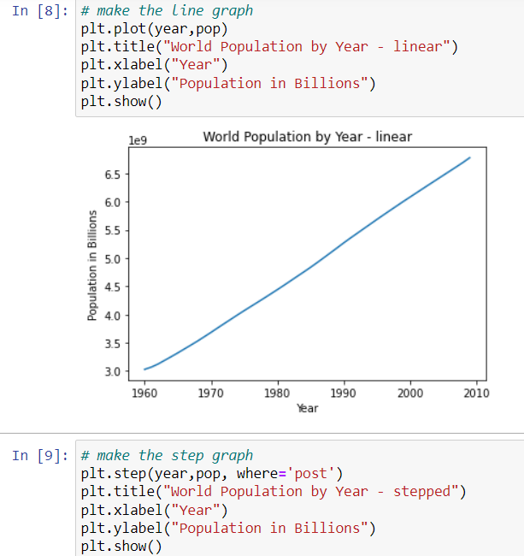
Python: Line and Stepped graphs of world population - CODE

Slide 6
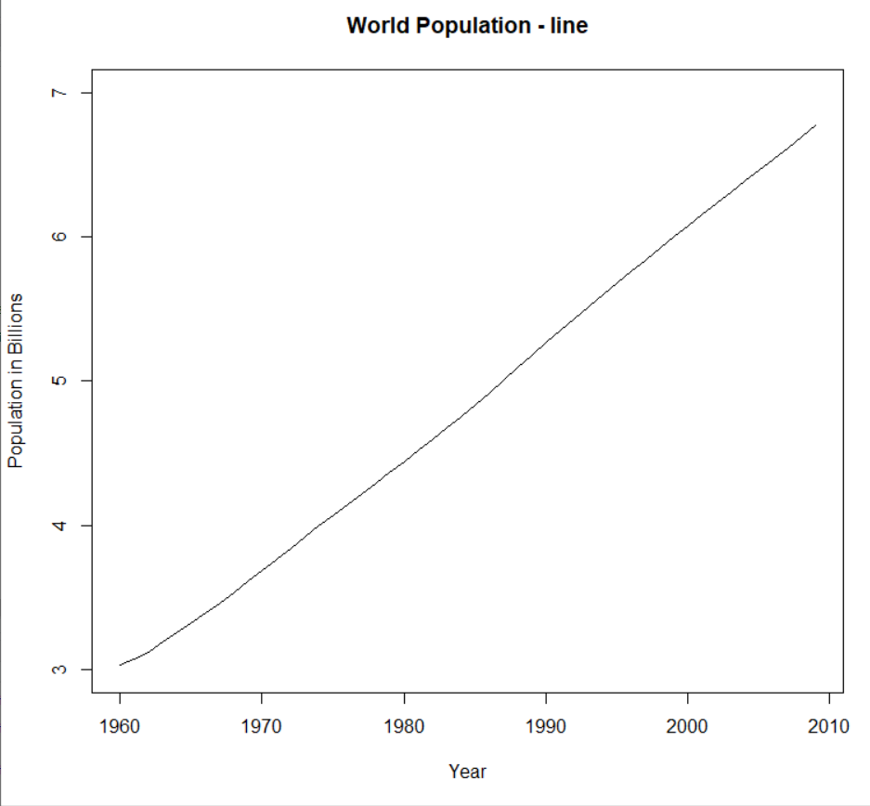
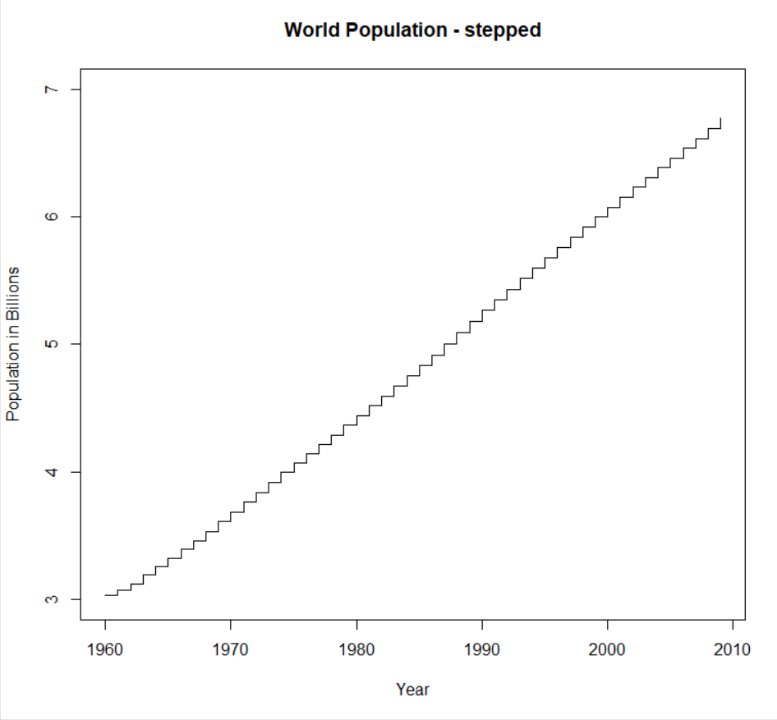
R: Line and Stepped graphs of world population

Slide 7
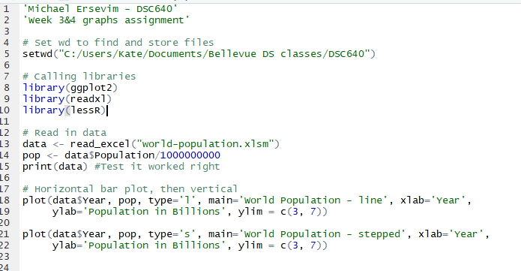
R: Line and Stepped graphs of world population - CODE

